Slide 1
Text Emotion Recognition
Recognization Emotions From Ensemble Of Features
BY
Vijay Kumar Sharma
Vinay Singh Parmar
Ravi Kumar Mishra

Slide 2
Contents:
Introduction
Why Emotions Recognition and Future Scope
Improvement in Dataset
Training the model
Improving Accuracy
Frontend or User Interface
Connecting trained model to Web application using Flask
Conclusion

Slide 3
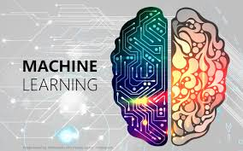

INTRODUCTION
Our Project is to train a machine so they can easily recognize the human Emotions after reading the text given by the human.

Slide 4
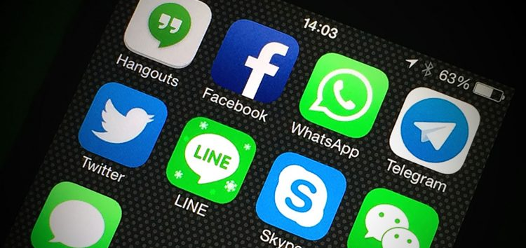

Scope or Future of Emotion Recognition
Comments on Social networking sites
Chatting Applications
Opinion Mining

Slide 5

DATASET

Slide 6
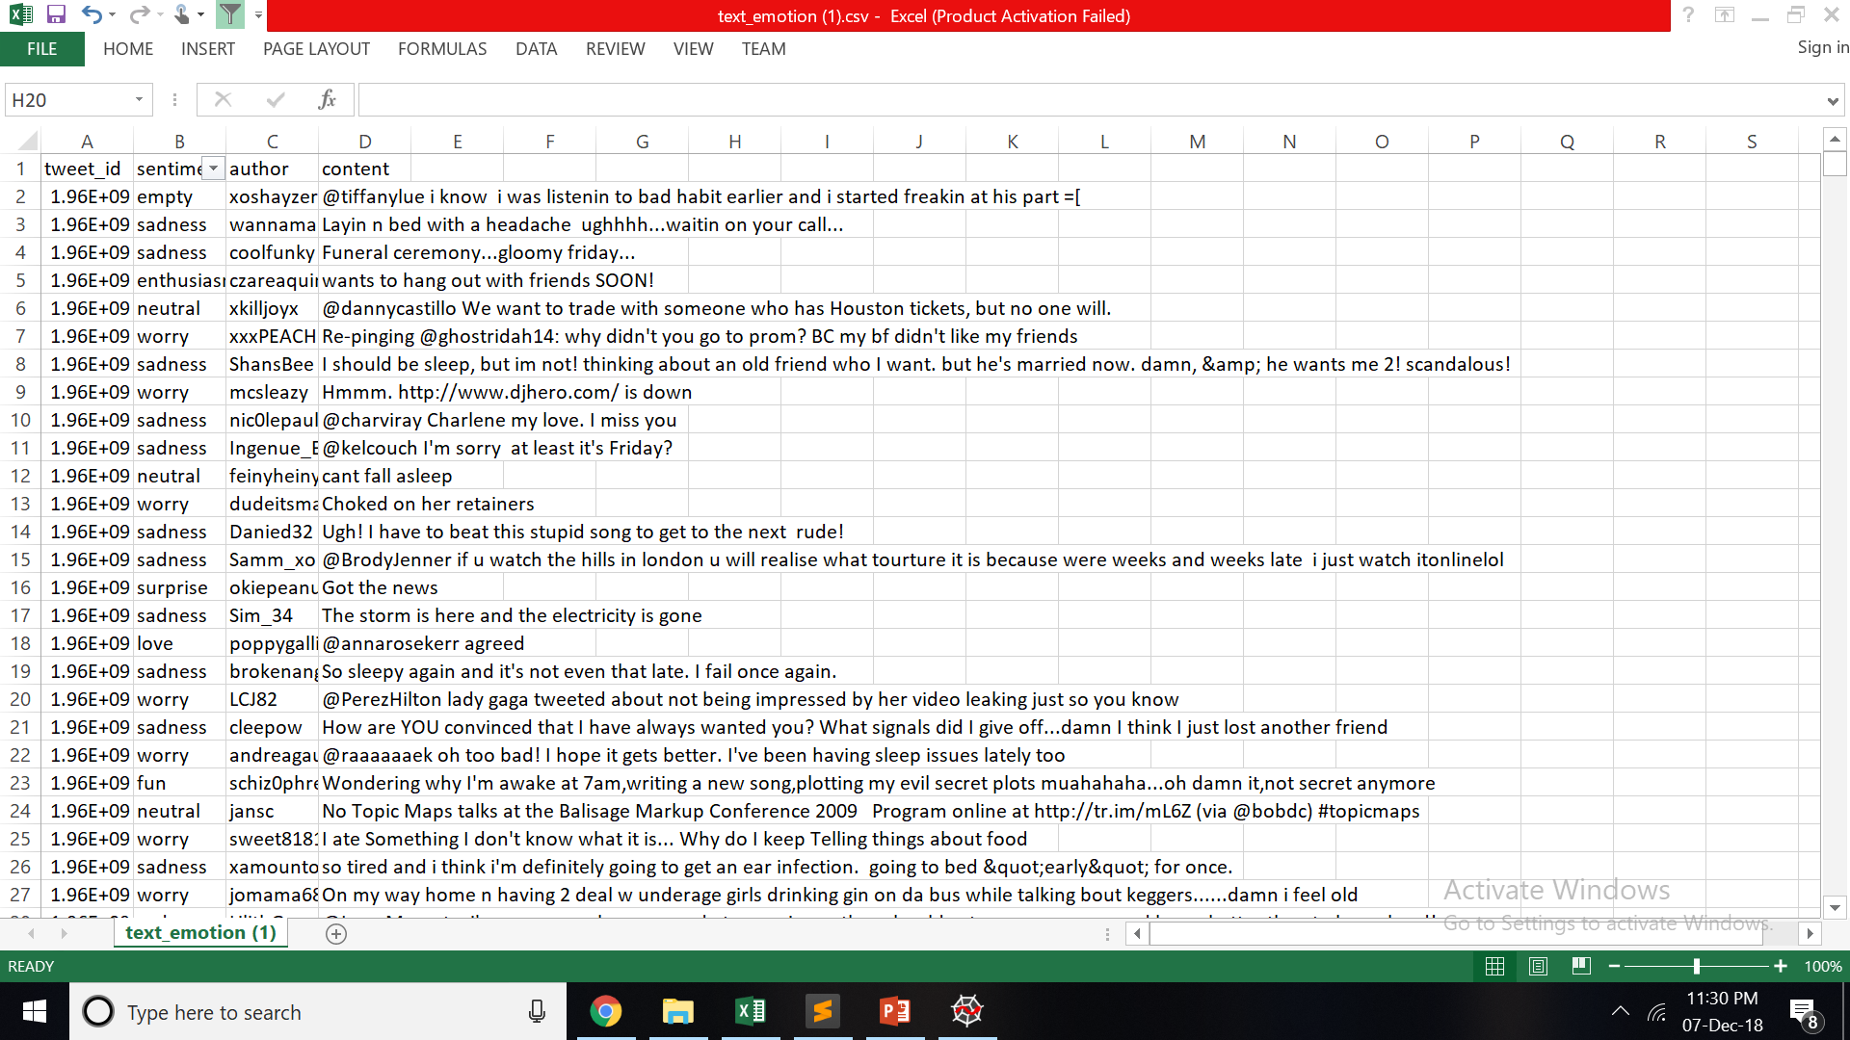
www.kaggle.com

Slide 7
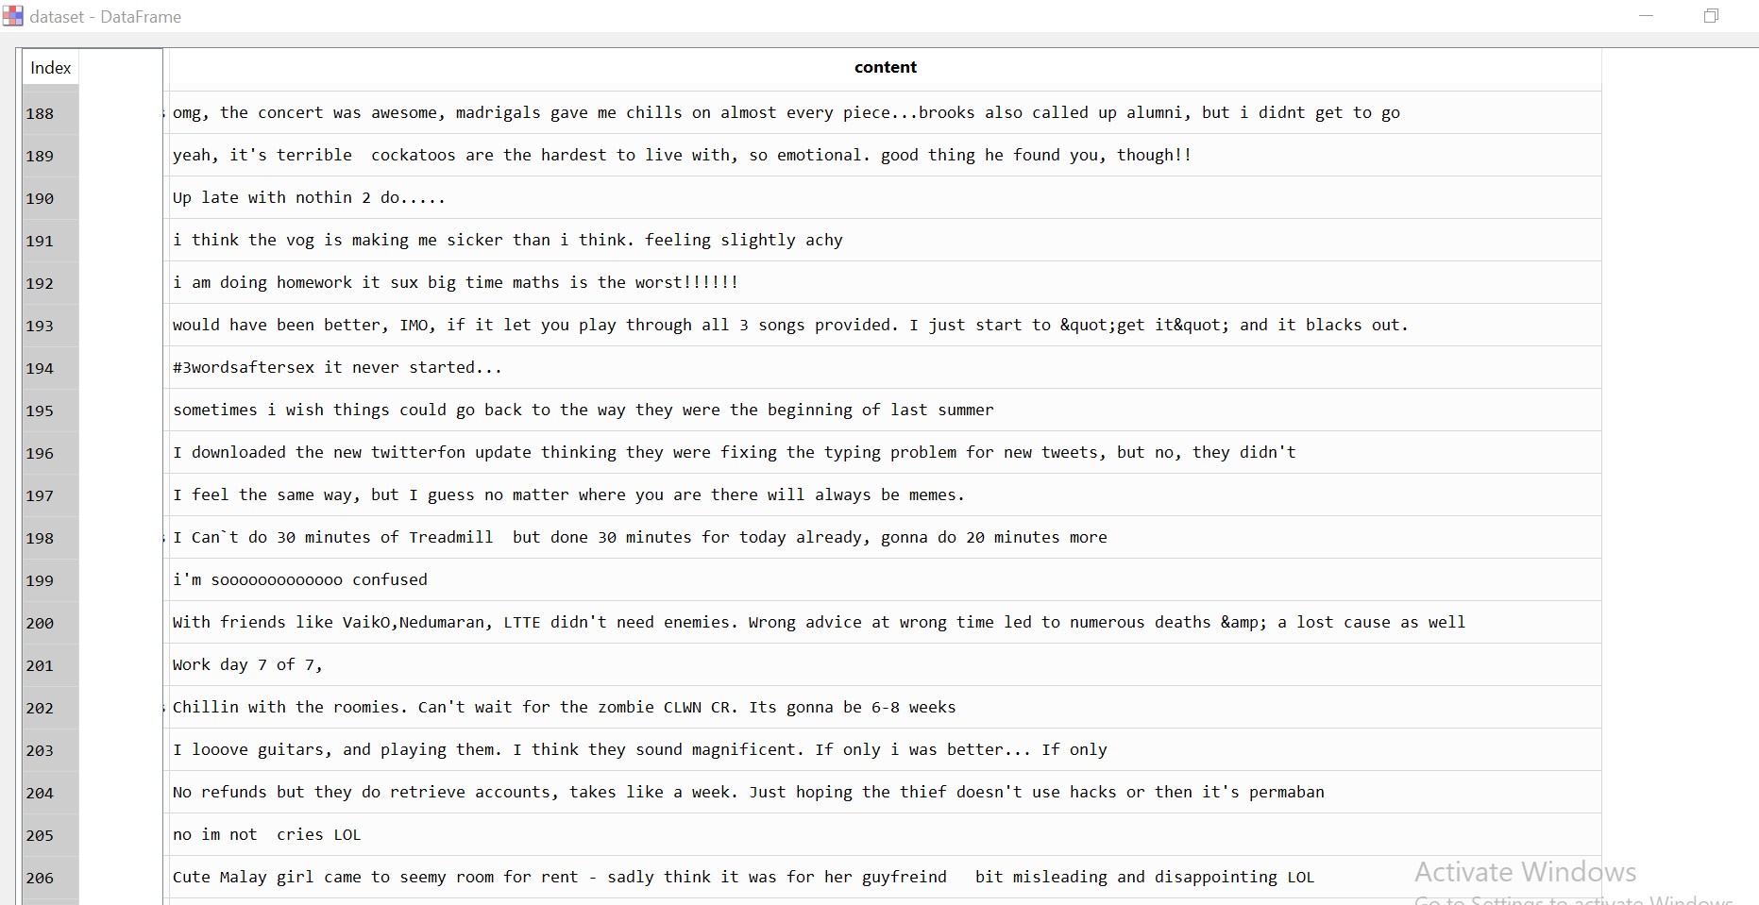
Improvement in Dataset

Slide 8
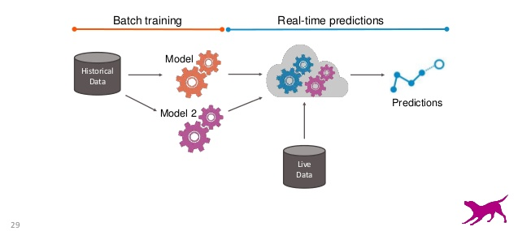
Train The Model

Slide 9
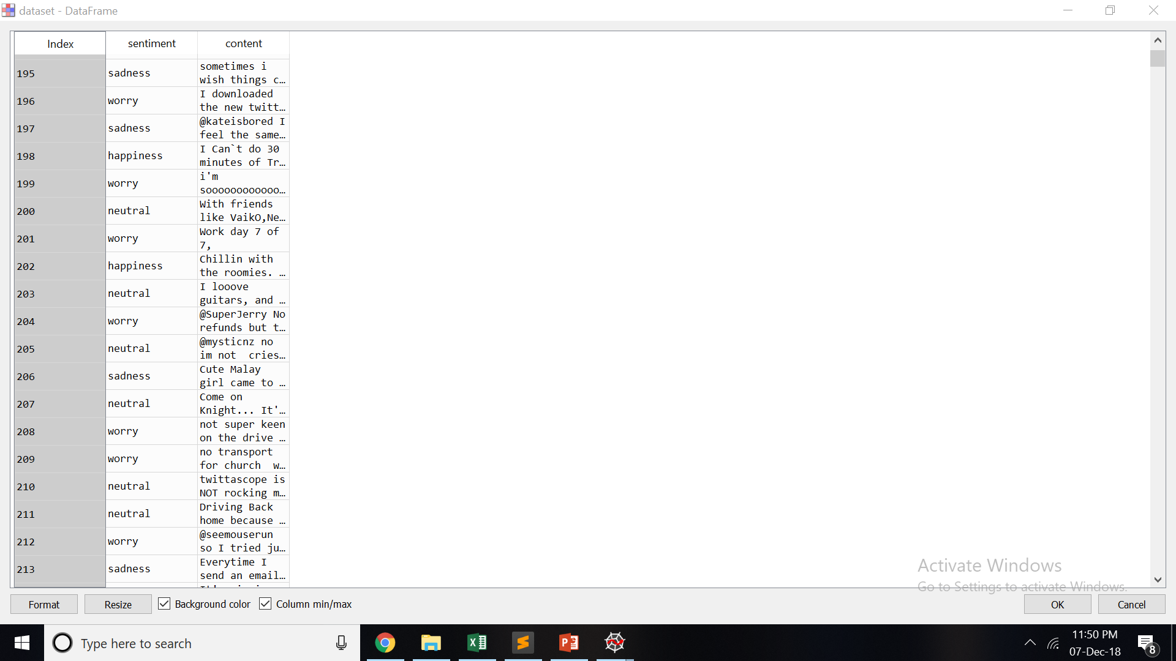
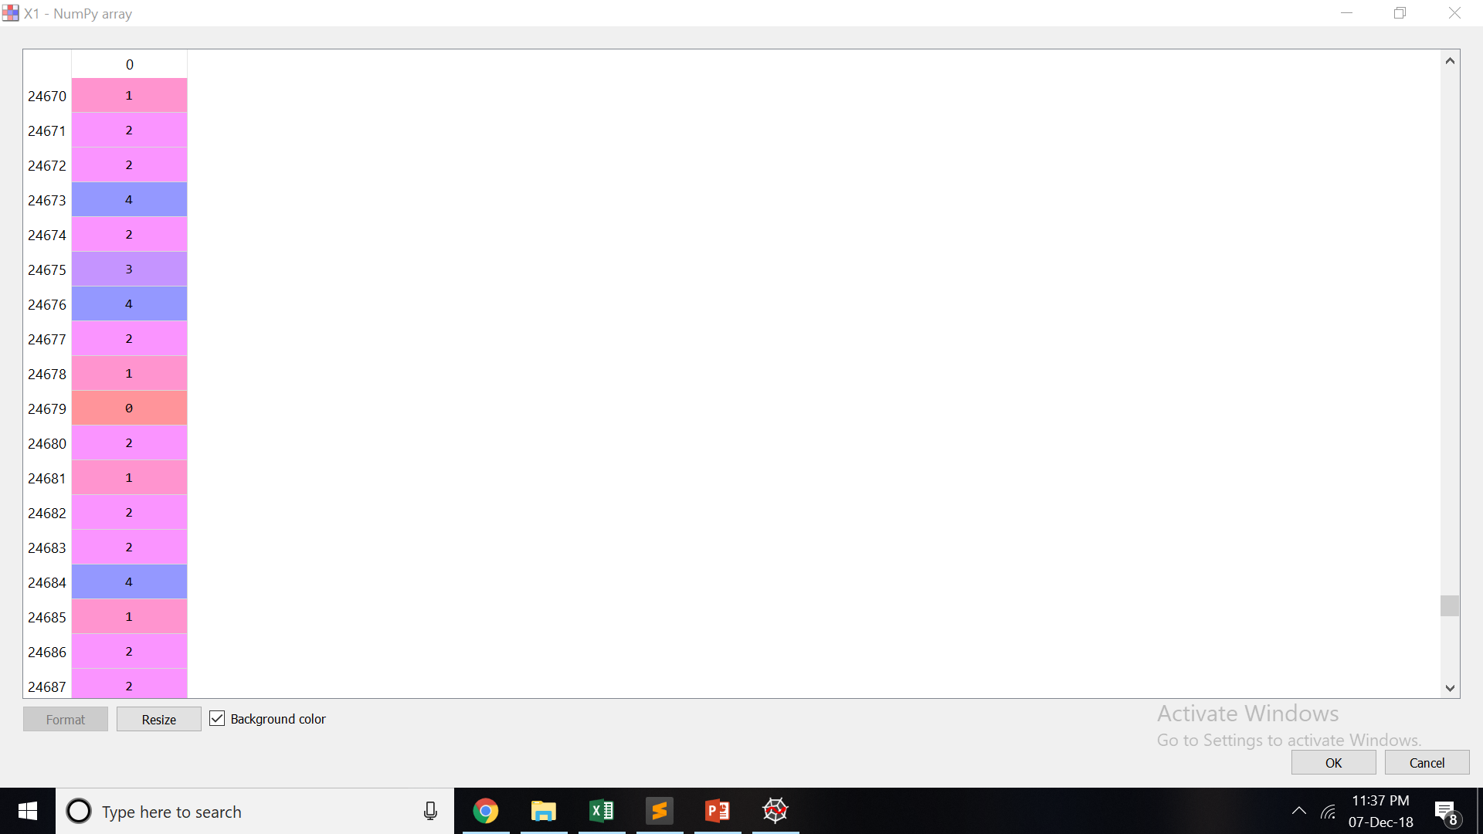
Training the Model
LabelEncode the Sentiments

Slide 10
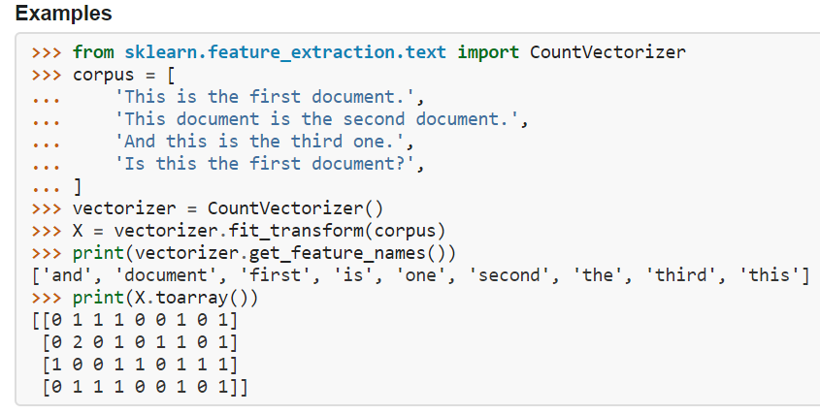
Training the Model
CountVectorizer

Slide 11
Training the Model
Classification Techniques
Logistic Regression
Decision Tree Classifier
Random Forest

Slide 12
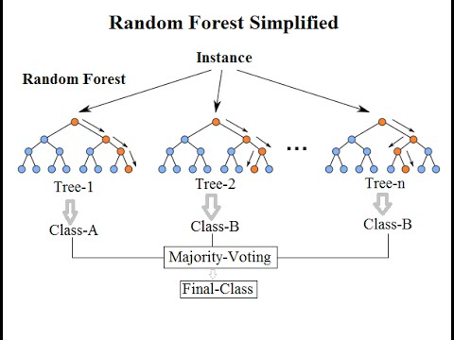
Training the Model

Slide 13

User Interface

Slide 14
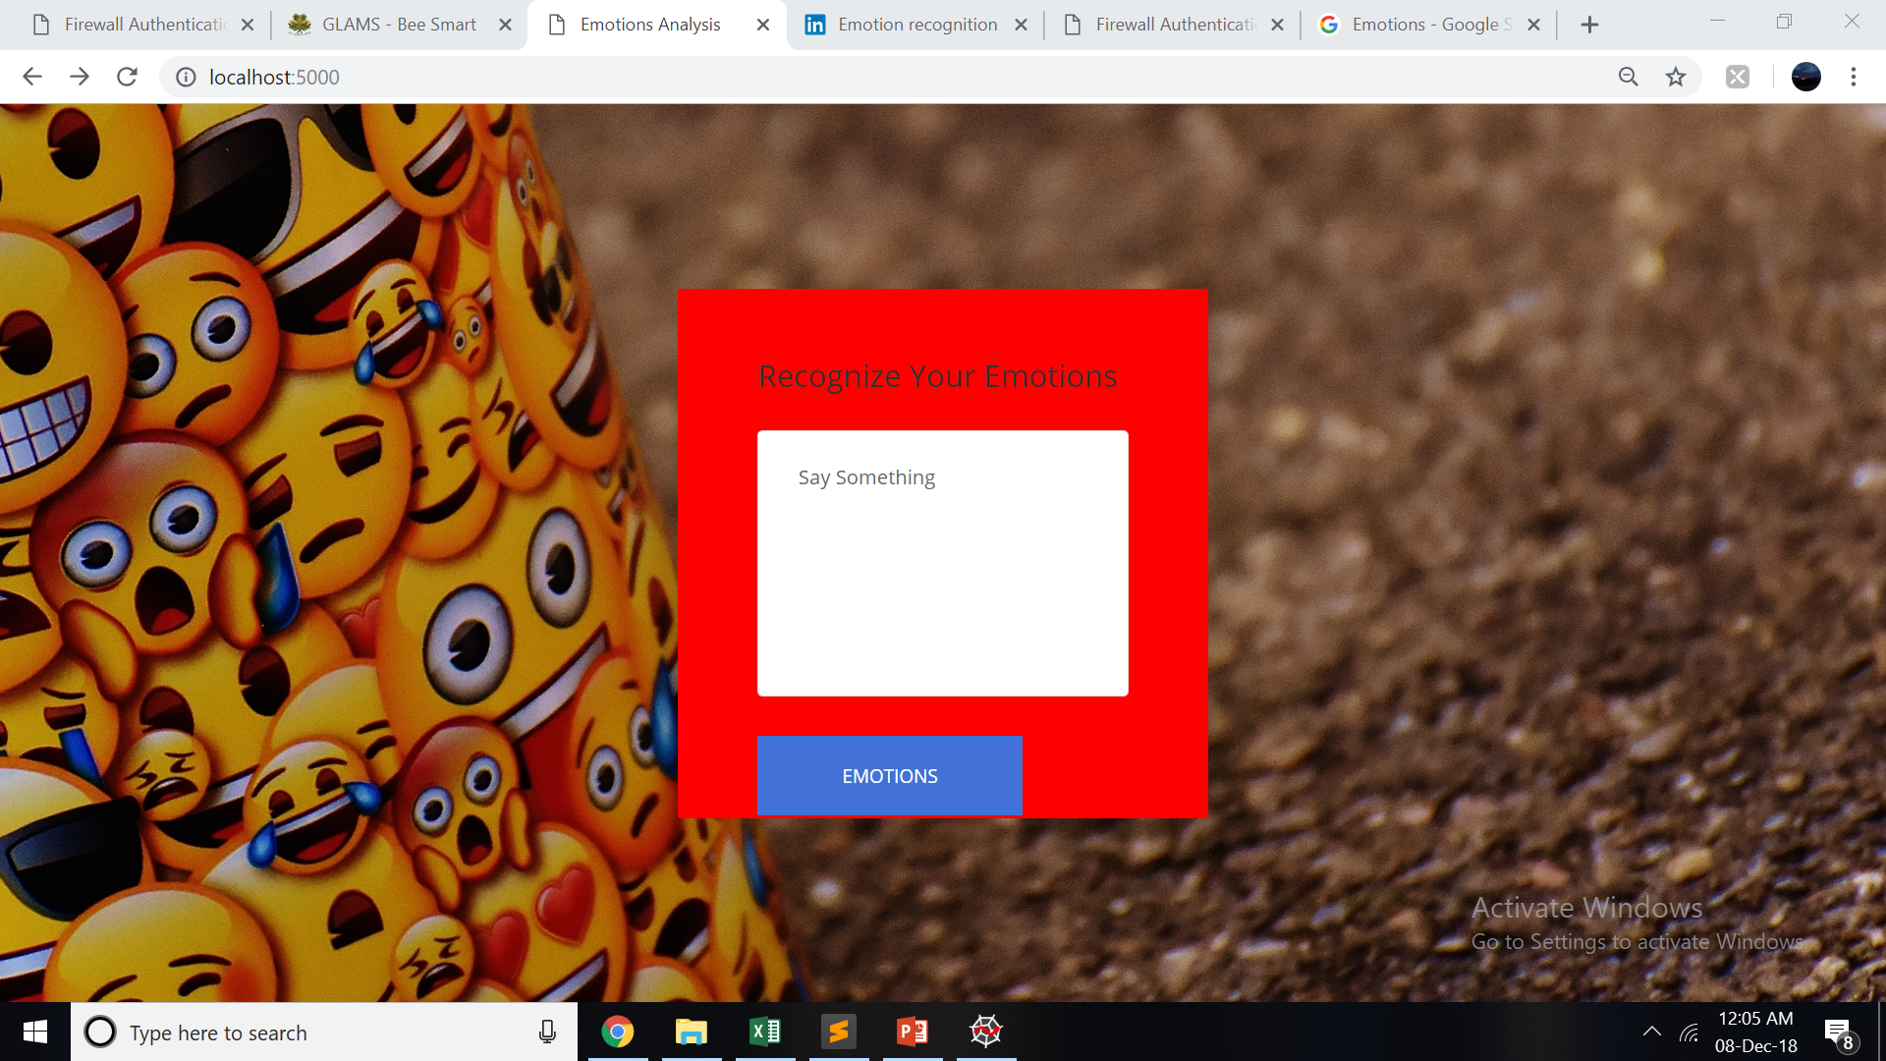

Slide 15

FLASK

Slide 16

Connecting trained model to Web application using Flask

Slide 17
Input => Output

Slide 18
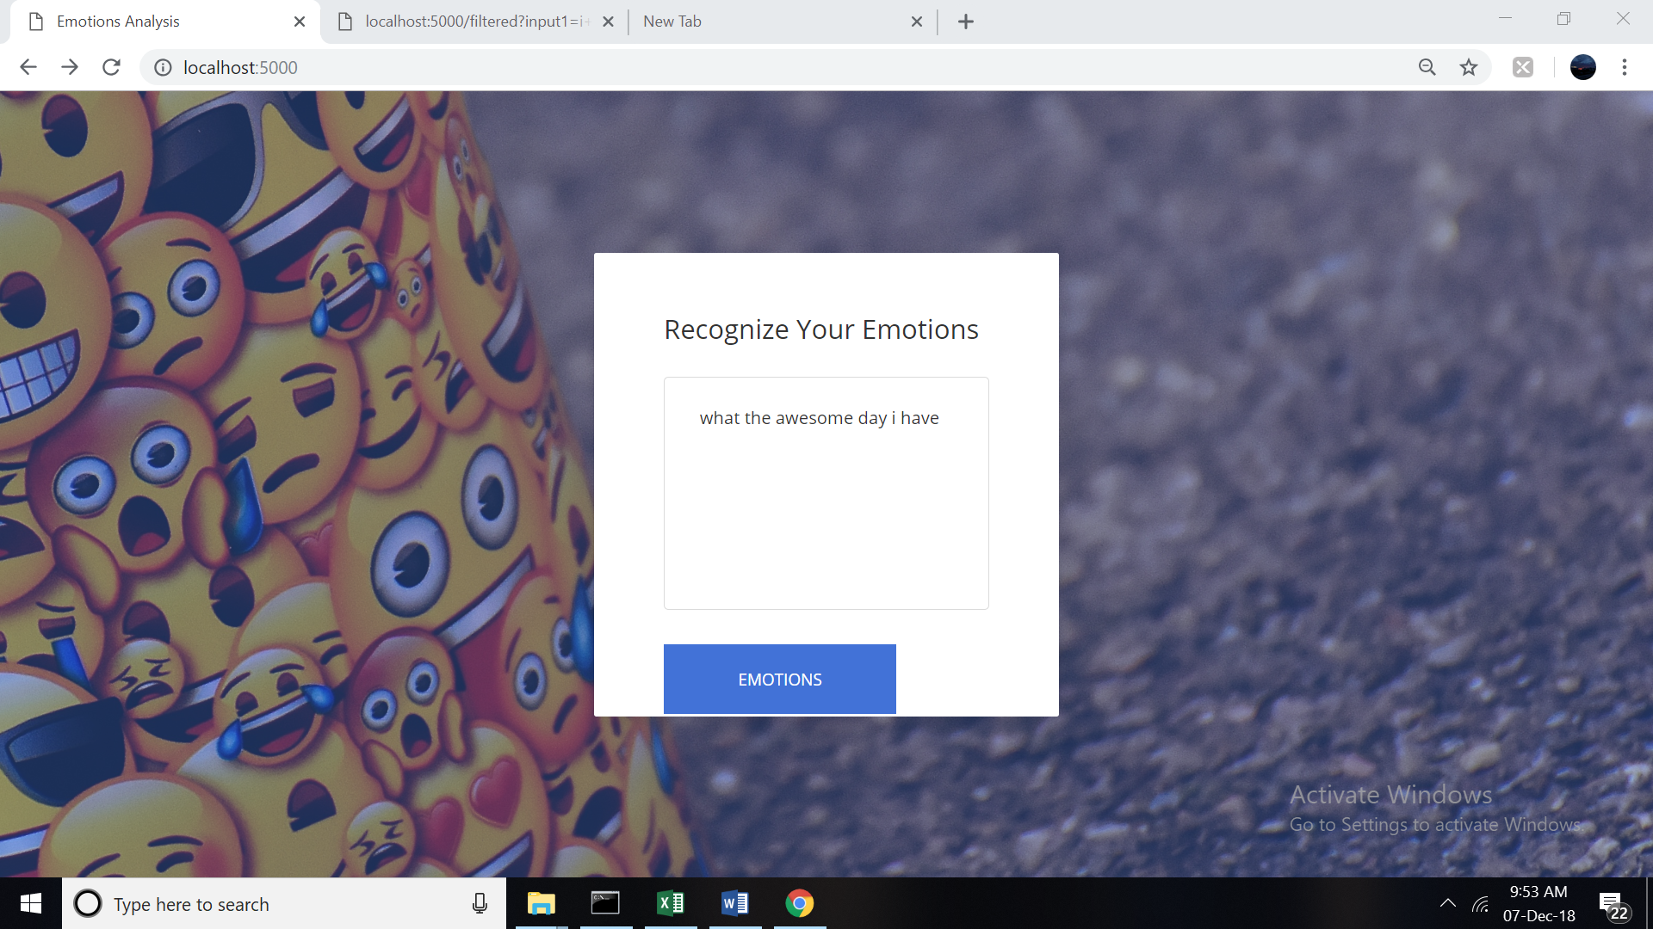
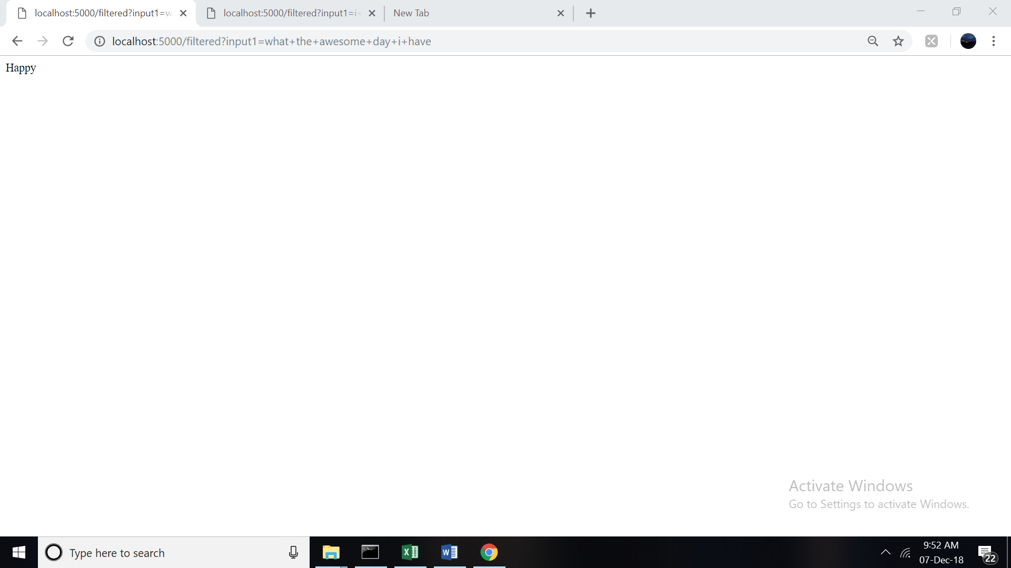

Slide 19
Thank You !!!

